Slide 1
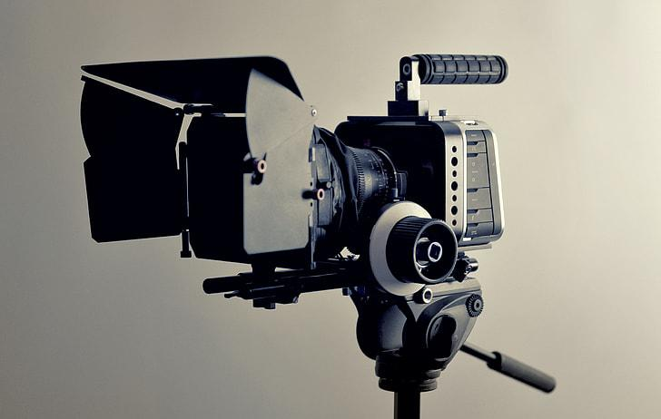
Filmmaking & Technology (Updates + Limitations)
Kevin Shreenauth

Slide 2


Case Study Updates
Case Study
Reviewing Films that debut certain film tech advancements and detailing how it aided the film?
Avatar (2009) James Cameron
3D motion capture technology
District 9 (2009)
Similar Sci-fi movie that was made with traditional filmmaking techniques to achieve 3D figures (smaller budget, tighter crew)

Slide 3
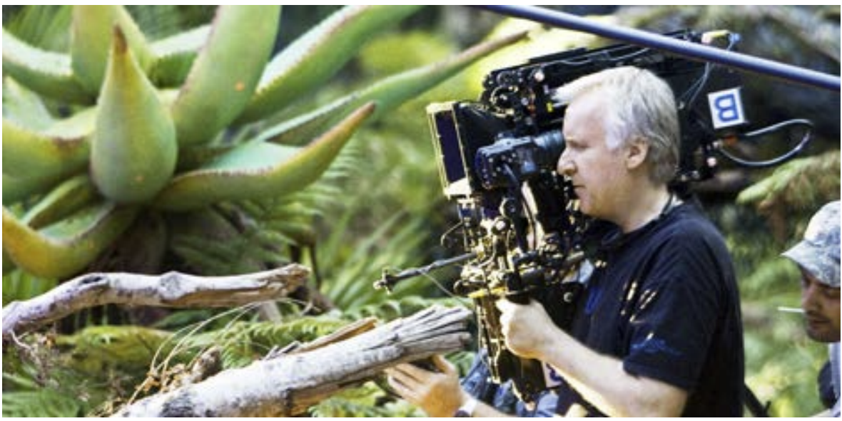
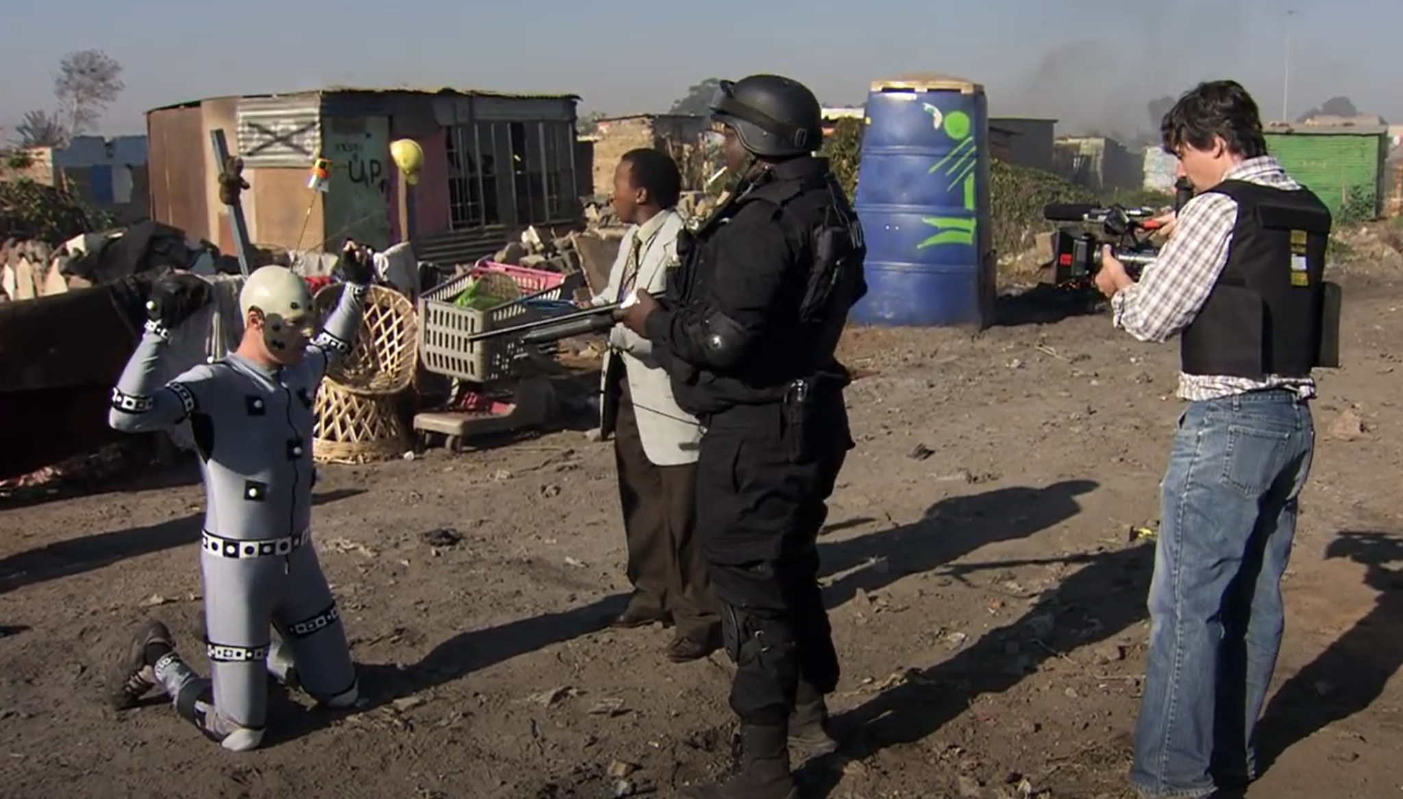
Initial Findings
The invention of the Simulcam specifically for Avatar allowed for CGI to be melded into the physical filmmaking process, which District 9 did not have access to. They also had access to bigger facilities to do full CGI work (with green and blue screens) with that allow the actor’s full body motions and facial expressions to be mapped onto a character created in CGI.
District 9 had significantly of a less budget, so more traditional methods of CGI were used mainly in post production, the physical filmmaking process was mixed with filming on live locations, using prosthetics, etc.

Slide 4
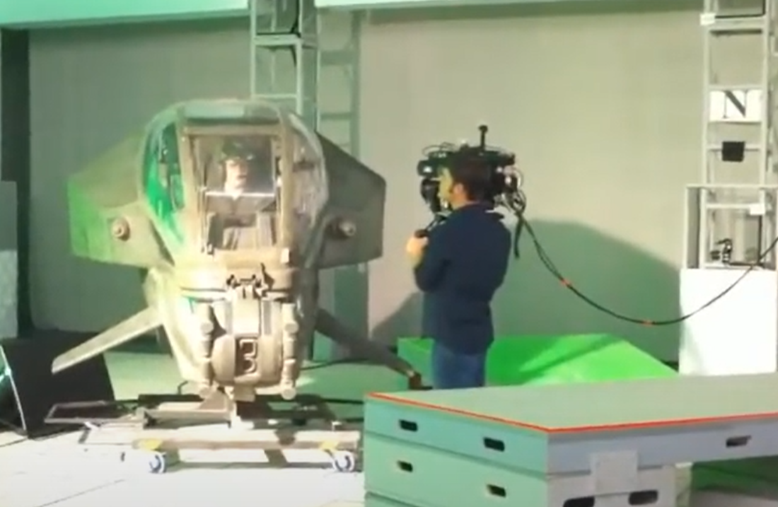
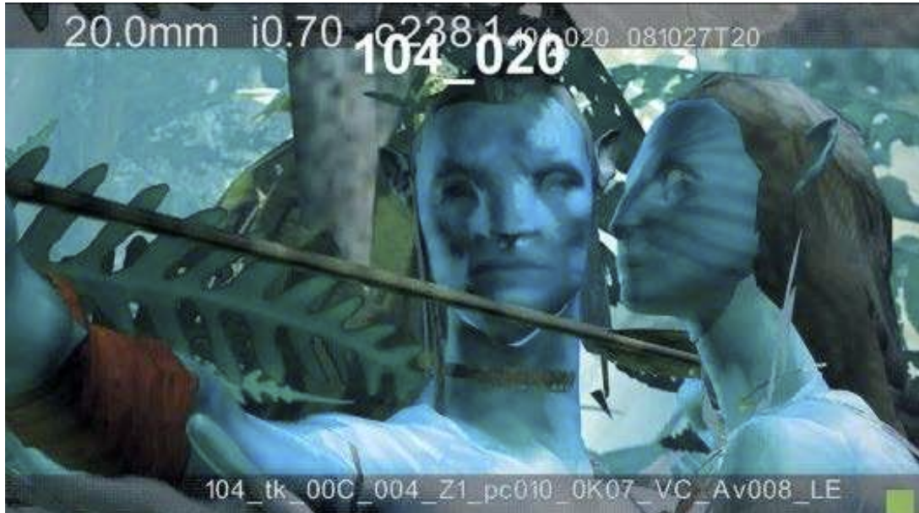
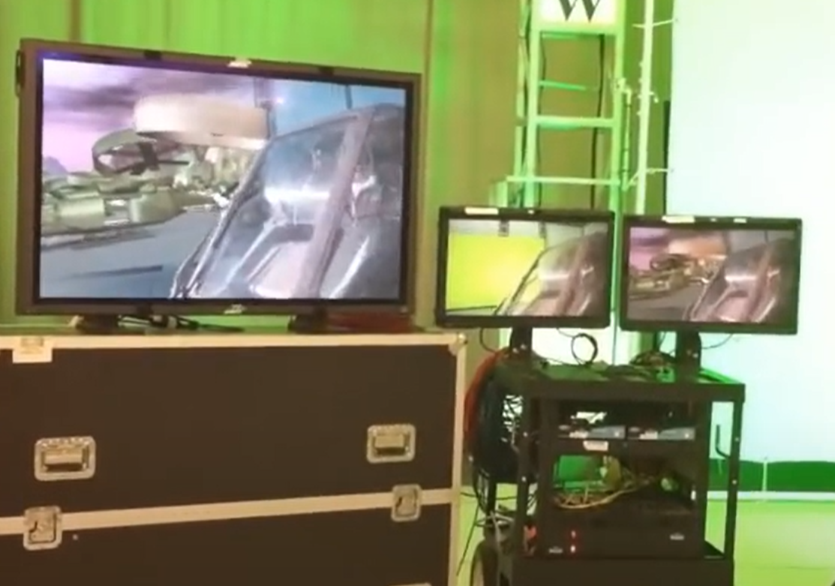
Initial Findings Continued
“the simulcam leverages, "a process that is more aligned with their experience of making movies" explains Casey Schatz, simulcam supervisor (youtube, simulcam). One of the numerous benefits of this process is that actors are able to react to elements that are physically present”

Slide 5
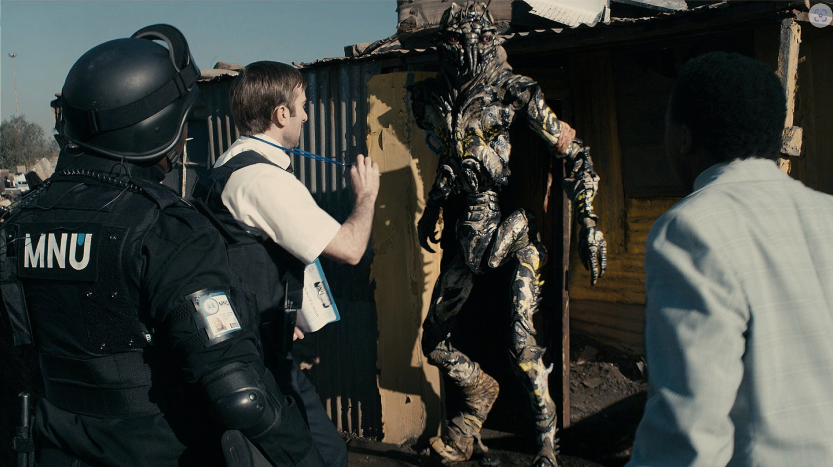
Initial Findings Continued
the film combined traditional techniques with the innovative use of CGI to create a gritty, documentary-style narrative about alien refugees in South Africa. Practical effects added tangible realism, while CGI enhanced the aliens' appearance and seamlessly integrated them into live-action footage.
“The initial challenges were exacerbated by the design of the aliens, who were designed with an extra ankle, similar to the leg of a canine. This required custom setups as the actors had to walk on stilts, which altered their gait significantly….The lead actor ended up joining the crew in Vancouver to retake some of the shots, to account for all the scenarios that were not accounted for during the initial shoot. All in all, this resulted in five extra days of shooting and three extra days of stunt work with Animatrik”

Slide 6
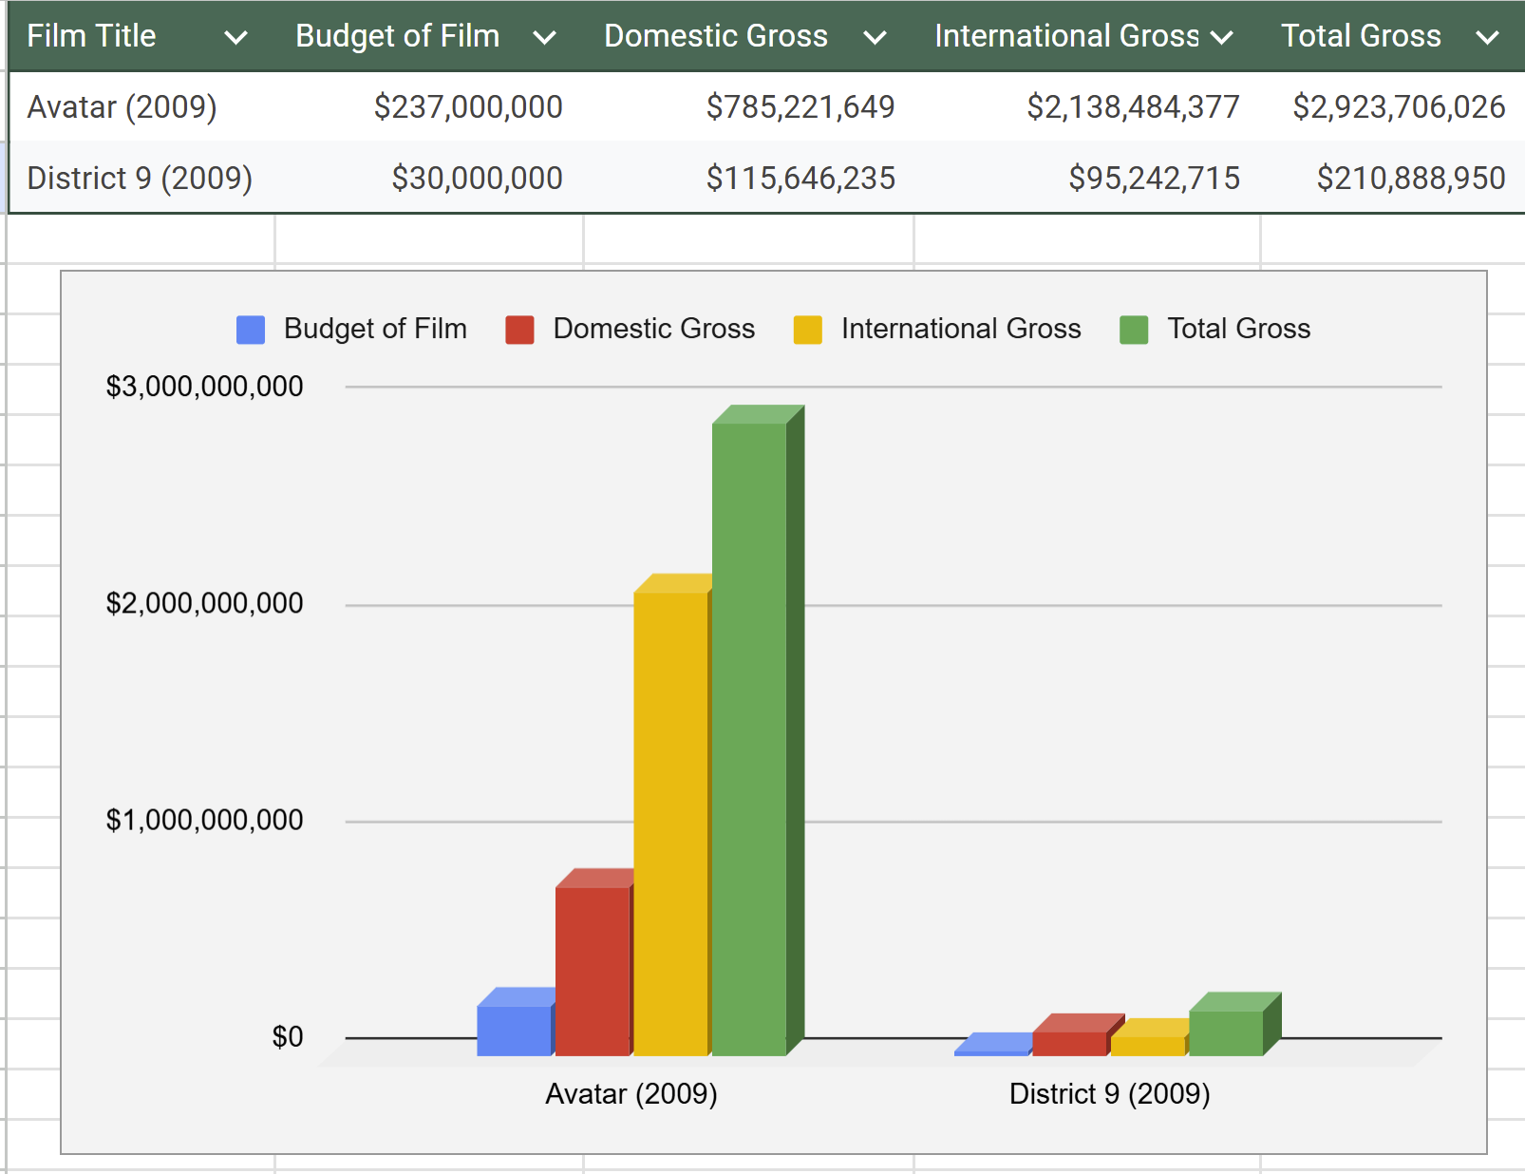
Initial Findings Continued
In order to draw better conclusions on the effect on quality and efficiency of these films, I decided to combine the exploration of tech in each film with each films respective performance. So far, it is clear that Avatar having access to better types of CGI and 3D technology with their bigger budget allowed them to perform higher in the box office.
But District 9 Also performed extremely well given the limit budget of this film. Their use of creative film techniques that were more traditional compared to Avatar saved the film’ ability to still engage audiences, even though the outreach of the film itself may have not been as extensive.

Slide 7
Limitations
Genre-Specific Bias
In my case study I am focusing on two Sci-fi films. I chose this because the need for advanced post-production technologies are in more of a demand for this type of film. However, if I chose a different genre of films it might have changed how I viewed access to technology and how it relates to performance (ex. Drama, Comedy)
Limited Access to True First-Hand Account Material
I obviously have no connection to Hollywood by any means, so I am basing my case study off of found behind the scenes footage and articles that have some first hand account material about the filming process for each respective film. In a perfect world, I could interview the directors to get a better sense of how they incorporated these technologies and how they themselves believed it propelled their storytelling.

Slide 8
Sources
Photograph of Ang Lee at the 85th Annual Oscars press room. (n.d.). AceShowbiz. http://www.aceshowbiz.com/images/wennpic/ang-lee-85th-annual-oscars-press-room-02.jpg
Ming, X. M. (2022). Post-production of digital film and television with development of virtual reality image technology-advance research analysis. Int. J. Mech. Eng, 7.
Avatar [Movie poster]. (2009). The Movie Database. https://image.tmdb.org/t/p/original/8Y7WrRK1iQHEX7UIftBeBMjPjWD.jpg
District 9 [Movie poster]. (n.d.). The Movie Database. https://www.themoviedb.org/t/p/original/kYkK0KIBygtYQzBpjMgQyya4Re7.jpg
All Games Network. (2023, June 14). The Impact of CGI in Modern Filmmaking [Video]. YouTube. https://www.youtube.com/watch?v=lyHa_0yJBlw&t=115s&ab_channel=AllGamesNetwork
Clare, L. (2014, August). A study of how the technological advances in facial motion capture has influenced the portrayal of character in film.
Animatrik Film Design. (n.d.). Behind the scenes of one of the most iconic sci-fi films of our times: The making of District 9. Animatrik. Retrieved from https://www.animatrik.com/blog/behind-the-scenes-of-one-of-the-most-iconic-sci-fi-films-of-our-times-the-making-of-district-9

Slide 9
Thank you.
Any Questions?

